Slide 1
Key points for gear machining process and creation of work standard chart
Key points for Creation of Work Standard Sheet & Gear Machining Process
Kyushu Musashi Seimitsu Co.
Production Engineering Section, Engineering Department Yanagihara
2021-04-20

Slide 2
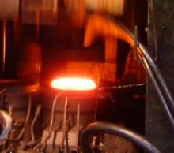
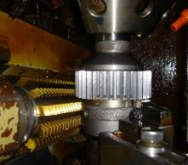
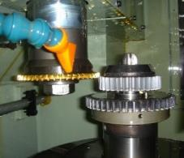
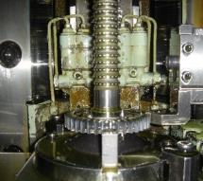
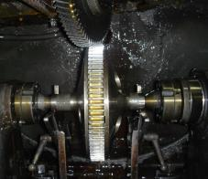
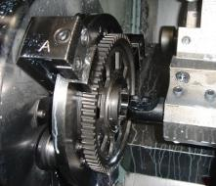
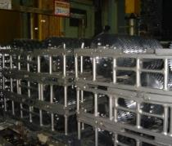
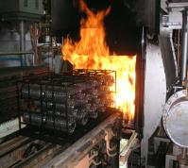
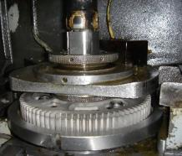
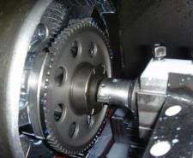
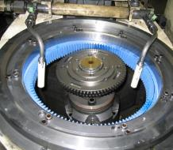
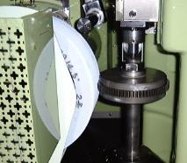
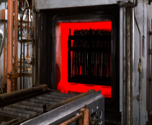
GEAR
Gear Machining (Example of Process)
Cutting | Casting | Turning | Broach | Hobbing | Shaving | Heat Treatment | ID finishing | Tooth surface finish | inspection
Shear cutting | Hot forging | Lathe | Hydraulic type | HOB | SV | carburization | honing | Gear grinding | engaging or meshing (of gears)
sawing off | Cold forging | Combined lathe | Mechanical | GS |  | carburizing and nitriding | FB | Gear honing | between shafts
 |  |  |  | Oil hole and tooth chamfering |  | shot blast
Process Image's ( Reference)
Method | FORGING | TURNING | HOB | GEAR SHAPER | BROACH | SHAVING
Process
HOB Cutter
pinion cutter
broach cutter
shaving cutter
(metal) mold
Material
work
work
work
Holder/Tip
work
work
Method | CARBURIZING | NITRIDING | ID HONING | ID BORING | Gear honing | dental lab
Process
furnace
furnace
Horn/stone
work
Internal Grinding Wheel
whetstone
work
work
work
Holder/Tip
work
work

Slide 3
Forming Process Cutting ~Forging

Slide 4
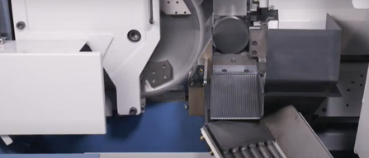
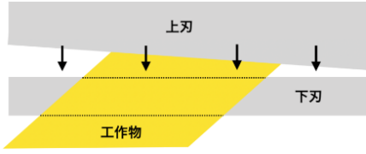
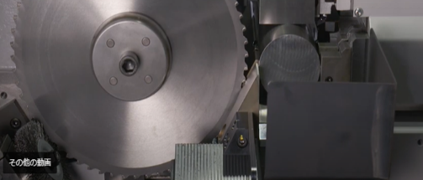
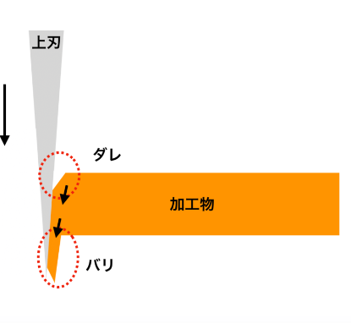
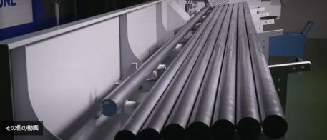
Cutting process
shirring process A machine that cuts materials into desired sizes (also known as a shearer). It has an upper blade and a lower blade, and works on the same principle as scissors. Basically, the upper blade is angled and can cut in a straight line.
Sawing process
Cutting steel to a certain length with a special circular saw
Burr and sag during shearing The upper blade is pressed against the workpiece to cut it, so the upper part of the cut is rounded by the press marks. This condition is called a dare (teisun mark). On the other side, the upper blade pulls the workpiece, resulting in a sharp cutting surface, which is called a burr.
Equipment for automatically supplying steel materials in fixed lengths

Slide 5
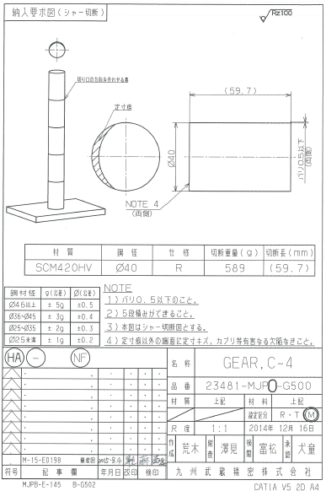
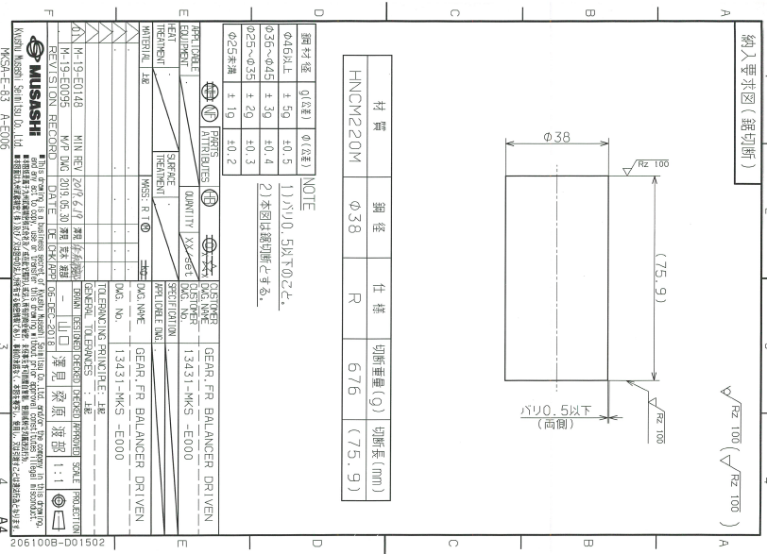
Cutting process Delivery requirement drawing
Shear cutting
sawing
 | Item | Perspective (Setting)
1 | Use the format of the delivery requirement diagram | Latest version of sawing diagram format (for external manufacturers)
2 | In the case of shear, roughness indication is black skin indication | Sawing cut surface is processed roughness indication
3 | dimensioning guide | (Only shear cutting drawing indicates constant dimension marks.
4 | Burr height indication | Shear and saw 0.5 or less
5 | Confirmation of five piles of cut products | Shear cutting only, to control the flatness of the cut surface
2
5
3
4
1
old format

Slide 6
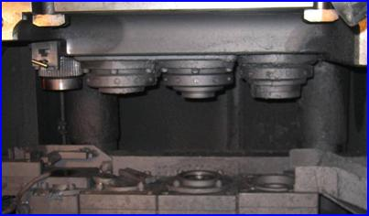
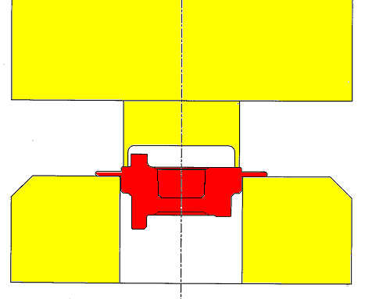
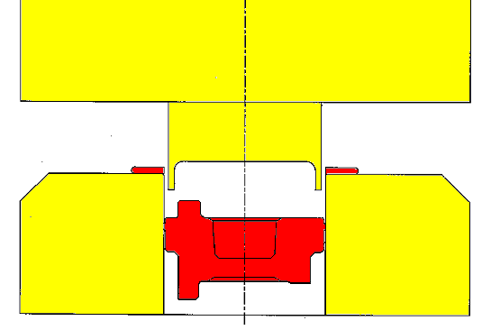
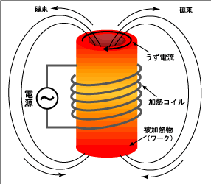
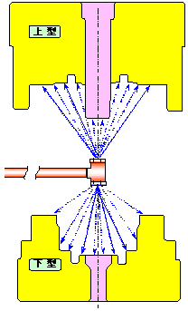
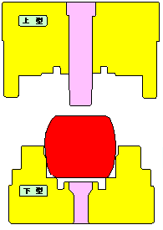
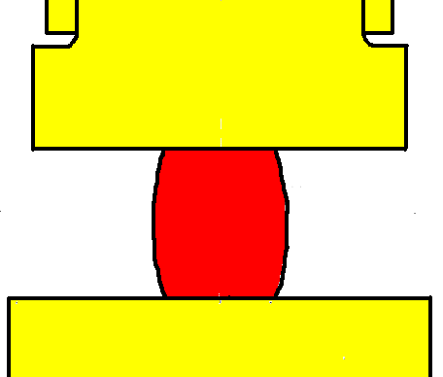
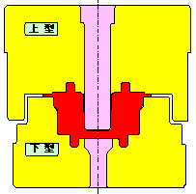
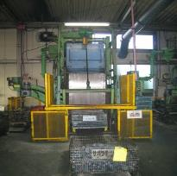
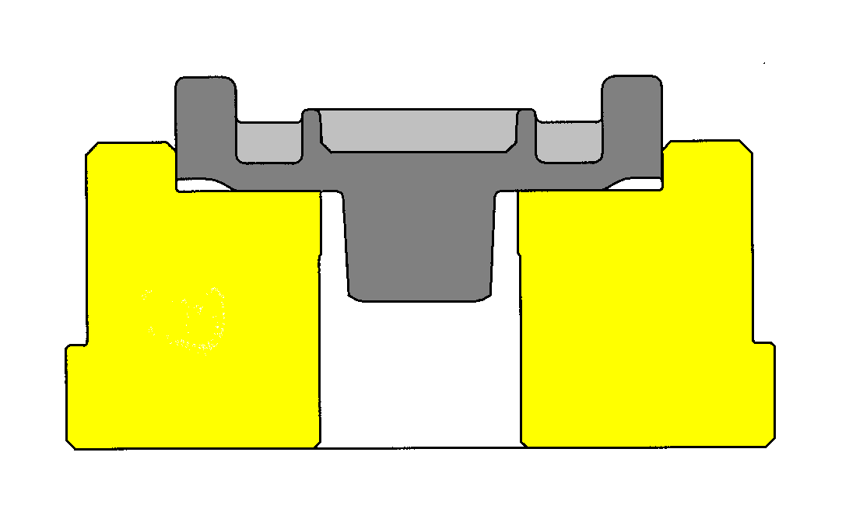









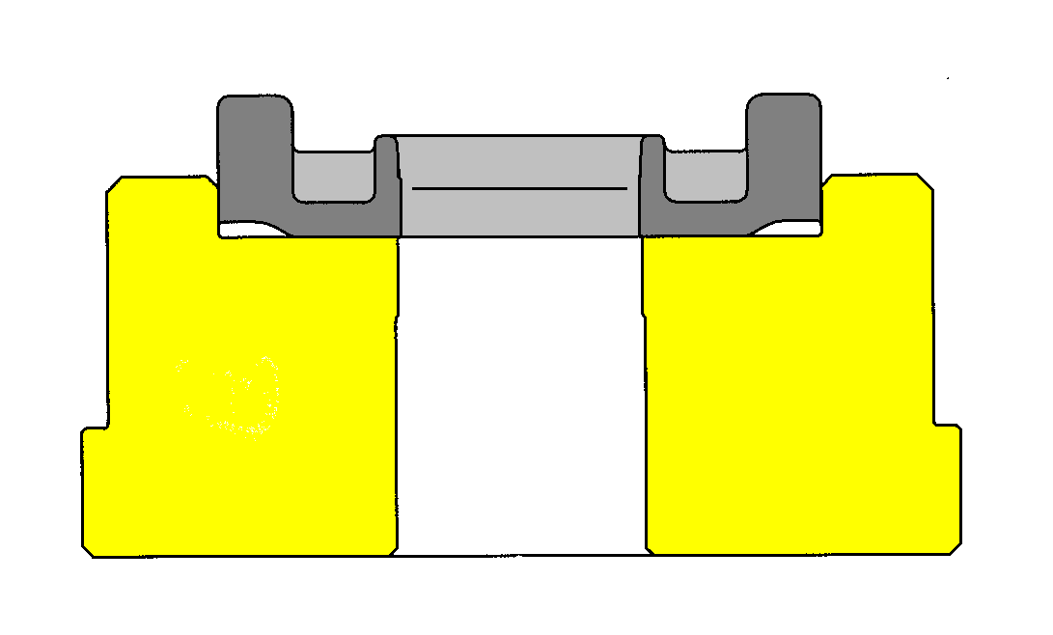
Hot forging - Piercing process
From the materials of the 2010 Technical Exchange Meeting
Hot forging process | Calcination process | Shot process | Piercing process
Remove any remaining scale from the surface.
Smoothen the surface.
Make a hole with a press machine. (shaft, window)
Shorter machining time per piece compared to drilling
The amount of scale produced can be reduced.
Easy to adjust temperature.
Organizational Coordination
Improvement of machinability
Residual stress removal
Press
furnace body
Continuous baking furnace
Billet heater
Billet heater
1600t press die set
Continuous baking furnace
heating furnace
preliminary blow
Preformed
Molding
trimming
Pinch roller
conveyor
rail
trimming
Heating coil
~
Set temperature
Time
hitting a ball (e.g. in tennis)
earrings
Use induction heating device
preliminary blow
Molding
Comparison by type
Type | billet | preliminary blow | Molding | trimming
semiclosed (Both dowels)
airtight (Bag dowel)
 | advantage | weak point
semiclosed (Both dowels) | The parallelism can be improved. It is suitable for shapes with significant unevenness. | Material yield will be reduced. A trimming process is required.
airtight (Bag dowel) | Improve the material yield. No trimming process is required. | The variation in parallelism becomes large. The corners are prone to chipping.
Before Shot
After shot
trimming
without

Slide 7
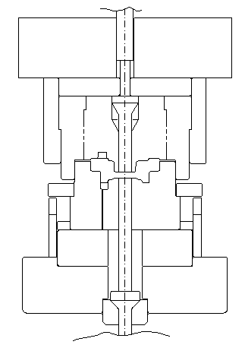
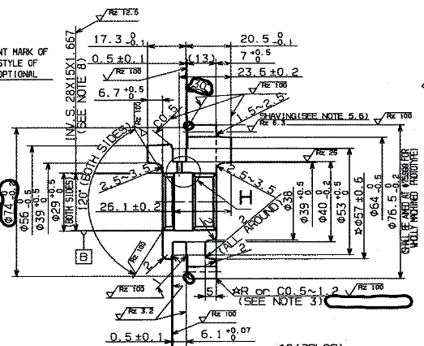
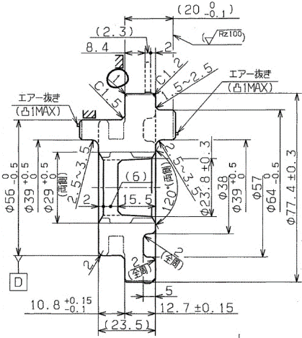
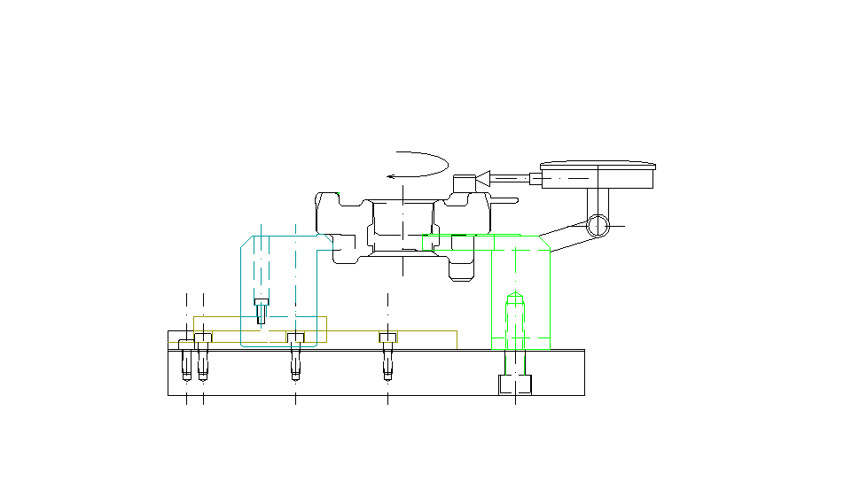
Hot Forging Material Design (Reference)
2006-From Material Design Standards
Machining tooling | Processing details
Hot forging
Product processing standards Forging (double dowel)
Perspective of material design (fleshing)
Where to clamp and where to process in Race 1
Where to clamp and where to process in Race 2
Where to leave the black skin (refer to the completed drawing)
Imagine the amount of money you need to take in.
It is important to check the shape of the spare parts, where to place them, and whether they are covered or missing.
Image the material processing, including the shape allocation position.
Is there any problem in the trimming process...bite step, dimensional change?
Dimensional changes, dents, dices, and chips are all concerns with shaft piercing.
(fogging, chipping, runout, deformation, cracking, molding, rough skin)
Is there an unreasonable balance in the number of man-hours required for the first and second lace processes?
Is the image (processing standard) completed from steel cutting to gear cutting?
upper mold
lower mold
Once you have the above in mind, you can start designing the material.
To build good products quickly and cheaply... Requirements for designers (awareness)
Good stuff.
Upper and lower mold misalignment measurement
(1) Do not remove the critical parts of the product. (dowel splitting, dowel length, missing wall, fogging)
Uniform production from the start to the end of processing is possible.
Quickly.
(3) Accurate design: One shot to produce a good product (NO mistake in design) => own verification required
Cheap.
(4) Unification of allowance by type: Design standardization, catalogization
5) Expansion of black skin
Let's verify the longitudinal dimension!

Slide 8
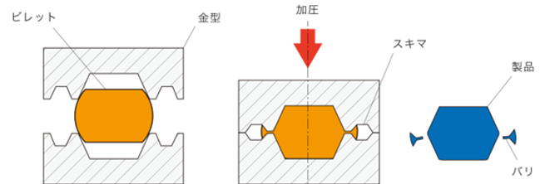
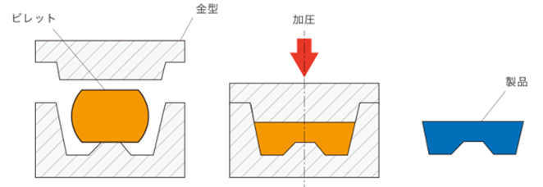
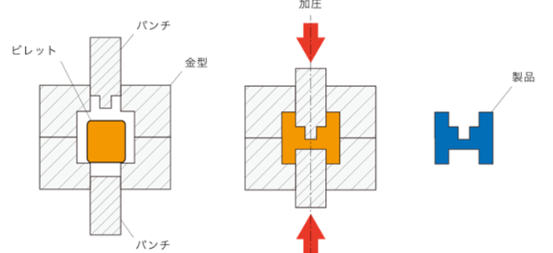
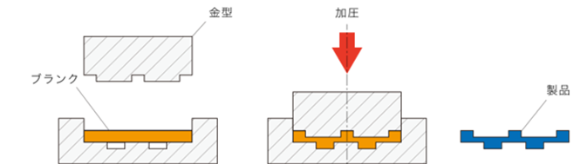
Type of forging process (Reference)
Semi-closed forging | Hermetic Forging
Closed forging | Press-stamping process (coining)
A billet (thick metal material) is placed in a pair of molds and compressed. By deliberately creating burrs in the gaps between the molds, the metal can flow all over the mold.
Burrs are removed by finishing process (trimming) In cold forging, the deformation resistance of the metal is high and the load on the die is large.
A billet (thick metal material) is placed in a pair of molds and compressed. Since there are no gaps in the mold, no burrs are generated and no finishing (trimming) is required.
Forged products are limited to round objects and are not suitable for forging complex shapes. Warm forging is used to increase the fluidity of the metal.
The billet (thick metal material) trapped in the mold is compressed by the punch. No burring due to the absence of mold gaps, eliminating the need for finishing (trimming)
Complex shapes can be forged depending on the movement and shape of the punch. Warm forging is used to increase the fluidity of the metal.
A processing method in which a convex and concave mold is pressed against a blank (thin metal sheet) to create a pattern. It is also called coining and is classified as cold forging.
Cost savings can be achieved by replacing cutting and casting Used in the mass production of coins, ornaments, and other small parts.

Slide 9
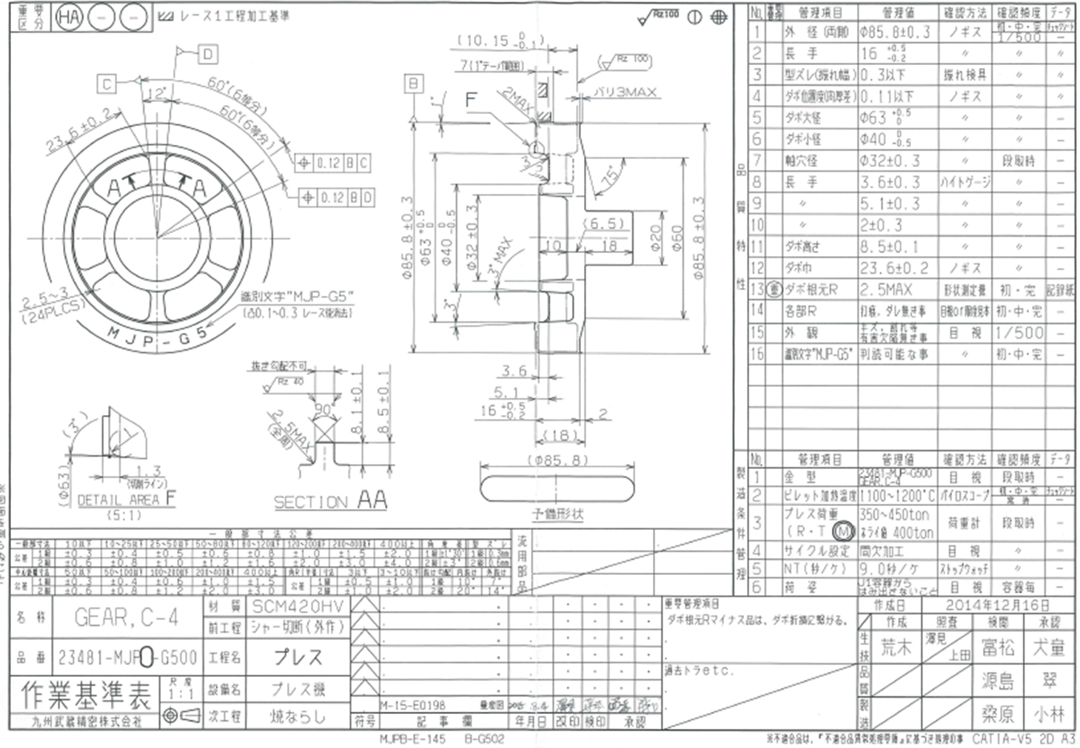
Press process work standard chart
2
 | Item | Perspective (Setting)
1 | Dictate processing standards clamping standards in the race | Indicate the direction of the lower mold Exclude the effect of press center misalignment
2 | Lace 1 process dimensions. instruction | long-armed management
3 | Indicate the direction and amount of burrs in the press | Race jig design
4 | Measurement of upper and lower mold misalignment | Minimum upper mold deviation
5 | The figure shows the degree of dowel position based on the outer diameter black skin area. | Lower mold direction = 0.12 Upper die direction = 0.16
6 | Preliminary shape is shown. | Prevention of molding defects
7 | distinguishing character | Parts identification (race deletion)
8 | General tolerance drawing | Site application without tolerance indication
9 | Billet temperature | Enter the temperature setting.
10 | Press load | Fill in the set load.
11 | Cycle setting | Indicate continuous or intermittent
12 | packing | Production control (packing format setting)
13 | priority management | List of priority management items
14 | past tense | Past tiger list
1
4
5
3
7
9
8
6
10
11
12
13
Priority management items (forging)
Key Quality Characteristics | Warranty management items | Item content (final event)
Dog Root R | Mold accuracy and life | Root R ・Crack and breakage for minus ・Dog loss for plus
Dog split accuracy | Mold accuracy, setup, and piercing | Unable to shift with mating gear, gear disengagement, gear tooth surface pitching
dogfish (any fish of family Squalidae) | Mold life management | Missing shift with counterpart
cabrilla crack | Mold control, foreign matter control | The product is damaged, and the surface is flaked, causing the gears to bite.
14

Slide 10
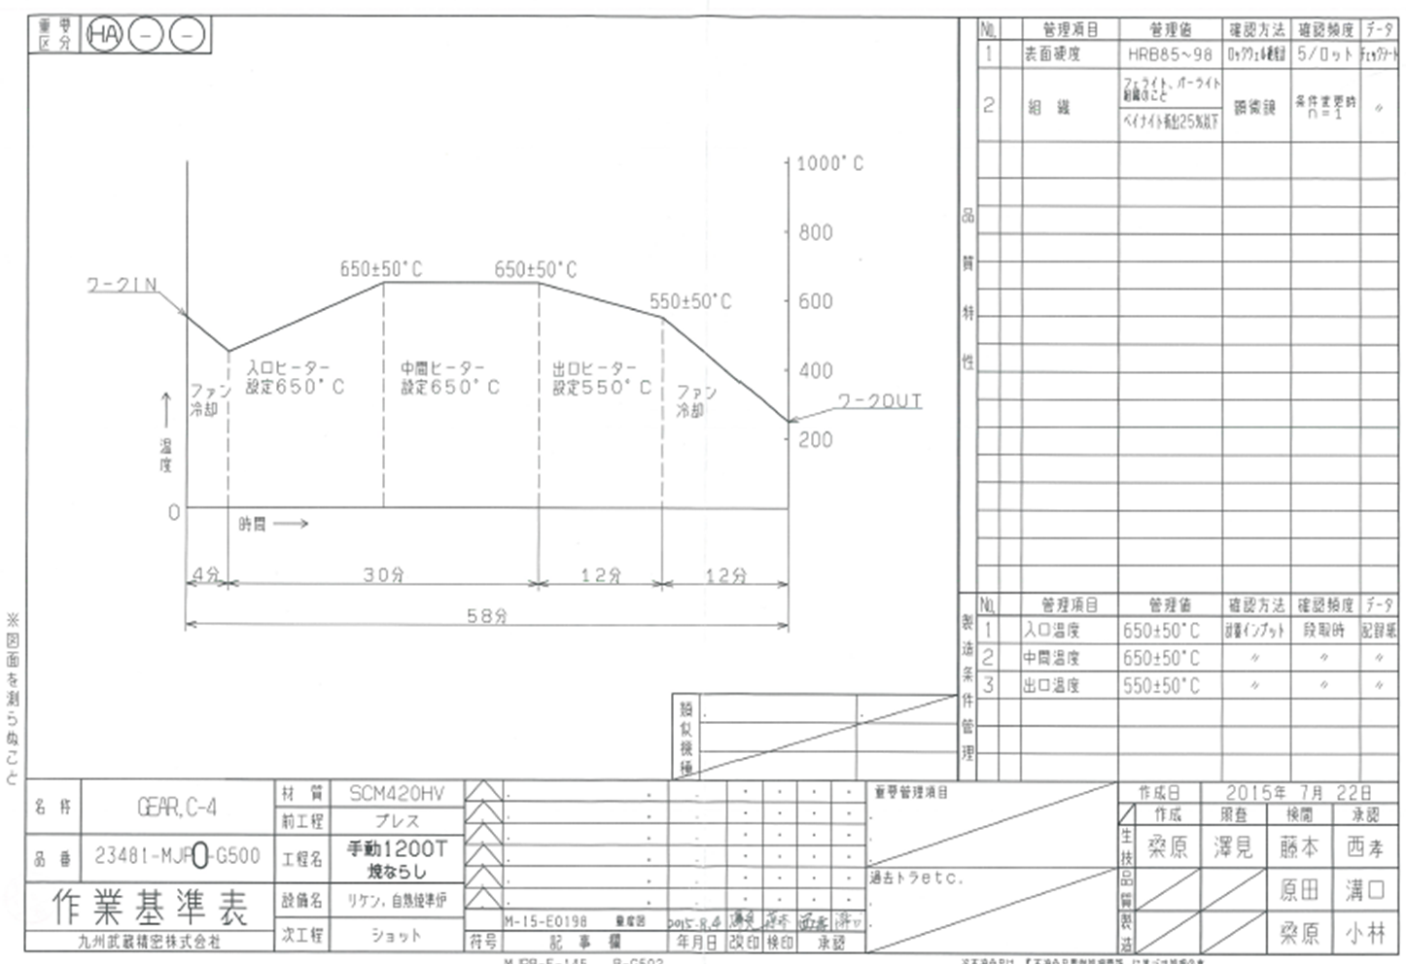
Tempering process Work standard chart
1
 | Item | Perspective (Setting)
1 | Surface hardness | Optimum hardness for cutting
2 | organization | Optimal organization during cutting
3 | Heat pattern diagram (Heat treatment conditions) | Temperature and feed time
4 | Heater setting temperature | Temperature at inlet, middle, and outlet management
5 | Focused management and past tiger | From the priority and past tiger list
2
3
4
Priority control items (burn level)
Key Quality Characteristics | Warranty management items | Item content (final event)
Surface hardness | Billet temperature and sintering conditions | Affects cutting accuracy and tool life
organization | Baking conditions | Bainite anomaly (excess) is too hard to cut.

